Slide 1
MILESTONE - 3
Data Visualization
Patterns
Team 1 Presents
Chandra Harshitha
Abhilash Reddy
Sartak Raj
Tasleem Banu

Slide 2
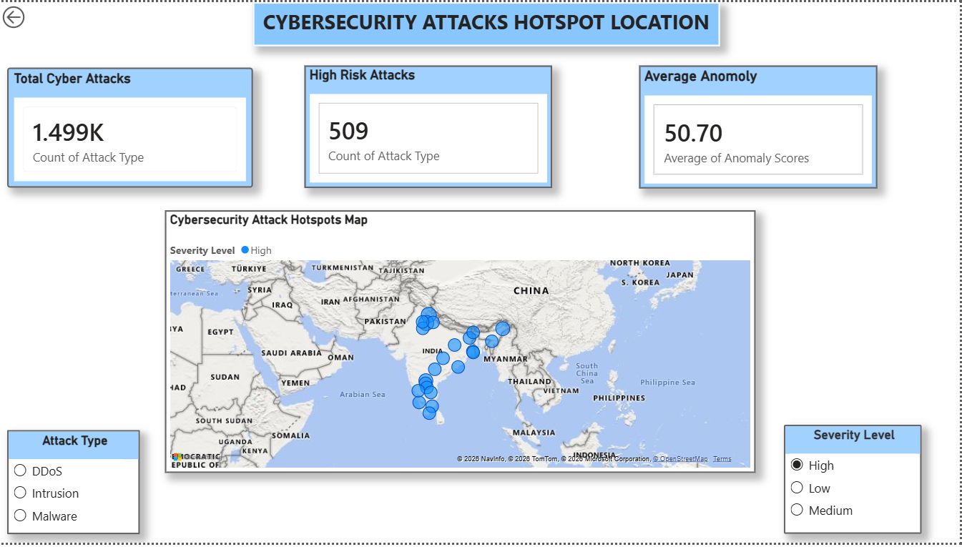
DASHBOARD 01
Cybersecurity Attack Hotspot Location
KEY POINTS
1
Maps 1.499K total cyber attacks with 509 flagged as high risk across the region.
2
Average anomaly score sits at 50.70, giving a baseline for unusual activity.
3
Interactive map plots hotspot clusters concentrated across South Asia.
4
Filters let viewers isolate results by attack type and severity level.
Data Visualization Patterns · Team 1 · Milestone-3
1 / 14

Slide 3
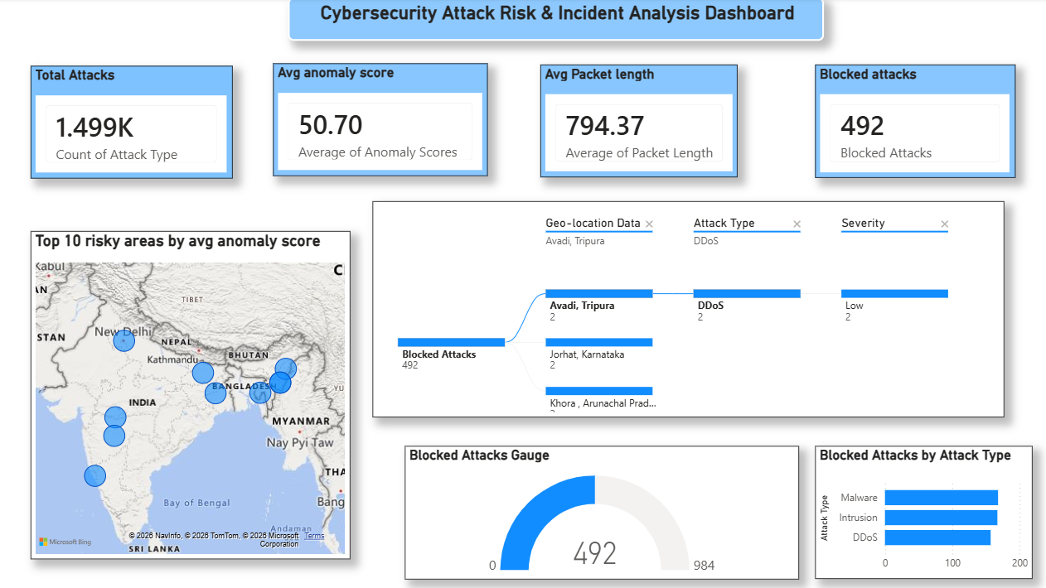
DASHBOARD 02
Attack Risk & Incident Analysis
KEY POINTS
1
Tracks 1.499K attacks with an average anomaly score of 50.70.
2
492 attacks were successfully blocked, shown live on a progress gauge.
3
A flow diagram traces blocked attacks from location to type to severity.
4
Top 10 risky areas are ranked by average anomaly score on the map.
Data Visualization Patterns · Team 1 · Milestone-3
2 / 14

Slide 4
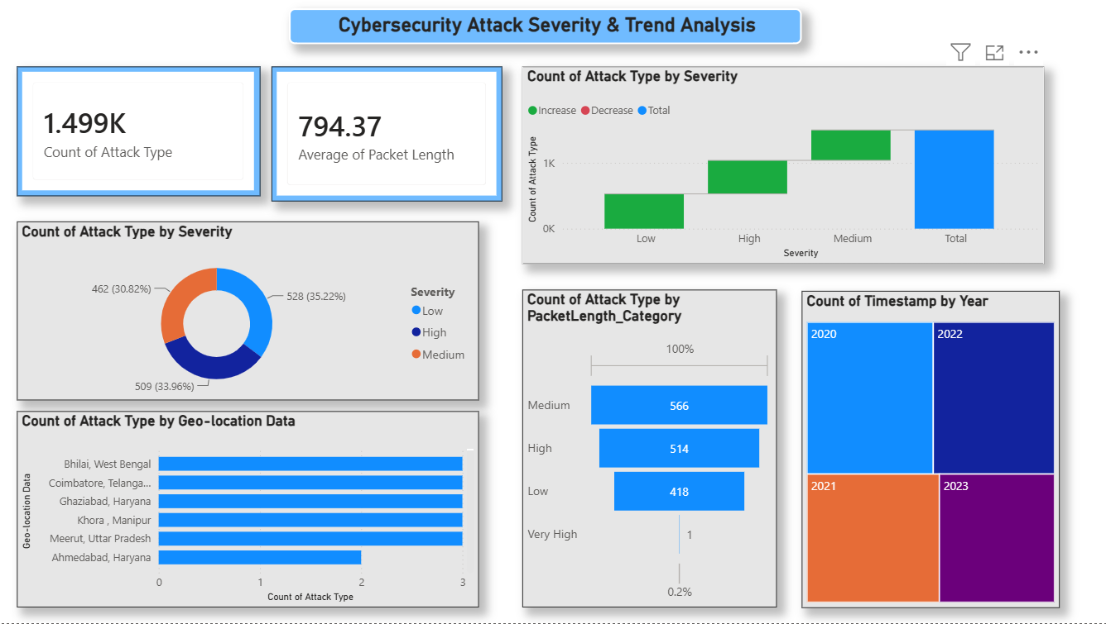
DASHBOARD 03
Attack Severity & Trend Analysis
KEY POINTS
1
Breaks down all 1.499K attacks by severity: Low, Medium, and High.
2
A waterfall chart shows how severity categories build to the total count.
3
Packet length is analyzed by category, averaging 794.37 across attacks.
4
A yearly treemap (2020-2023) reveals how attack volume shifted over time.
Data Visualization Patterns · Team 1 · Milestone-3
3 / 14

Slide 5
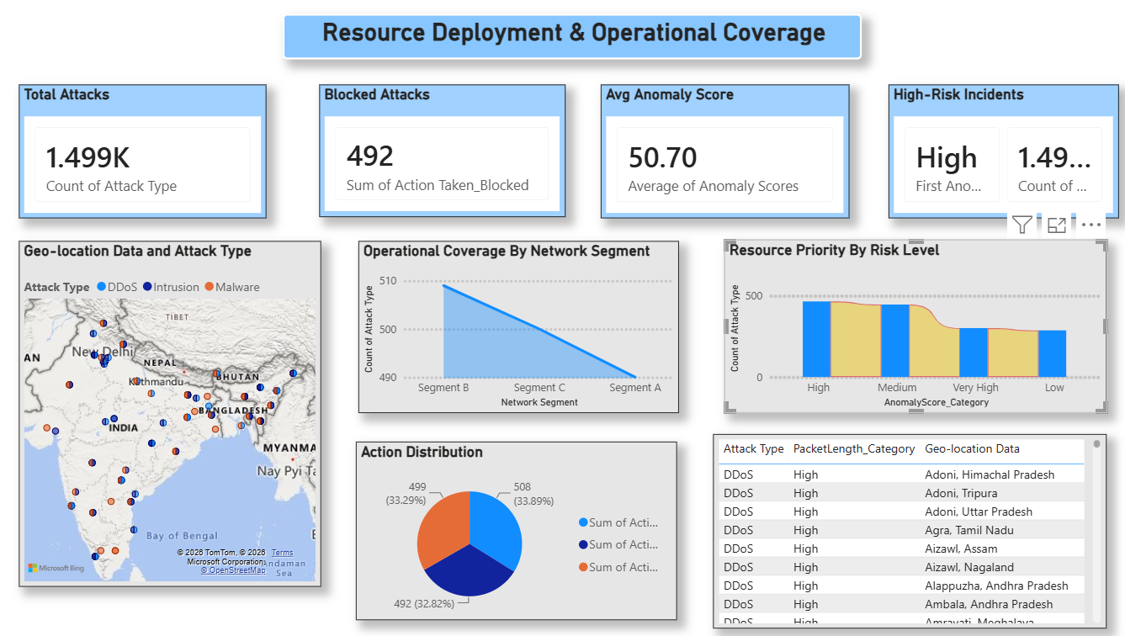
DASHBOARD 04
Resource Deployment & Operational Coverage
KEY POINTS
1
Combines 1.499K total attacks with 492 blocked for a coverage snapshot.
2
A geo map layers attack type on top of location for spatial context.
3
Operational coverage is compared across three network segments.
4
A response table cross-references attack type, packet length, and location.
Data Visualization Patterns · Team 1 · Milestone-3
4 / 14

Slide 6
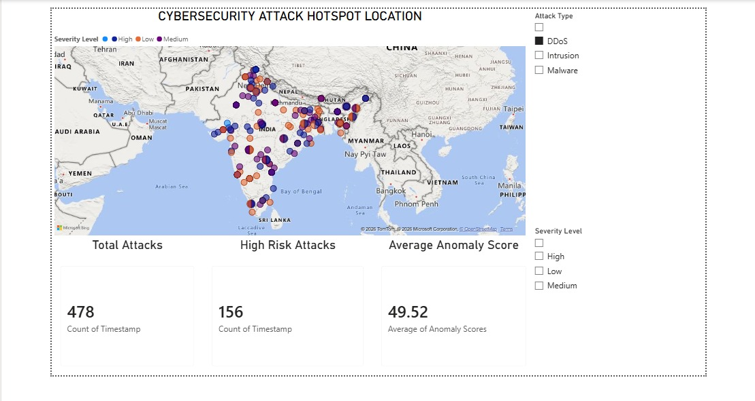
DASHBOARD 05
Hotspot Location — Severity Drilldown
KEY POINTS
1
Zooms into 478 attacks with 156 classified as high risk in this view.
2
Average anomaly score for this slice comes in slightly lower at 49.52.
3
Bubble markers on the map are split by severity using color and pattern.
4
Attack type and severity checkboxes let users filter to DDoS specifically.
Data Visualization Patterns · Team 1 · Milestone-3
5 / 14

Slide 7
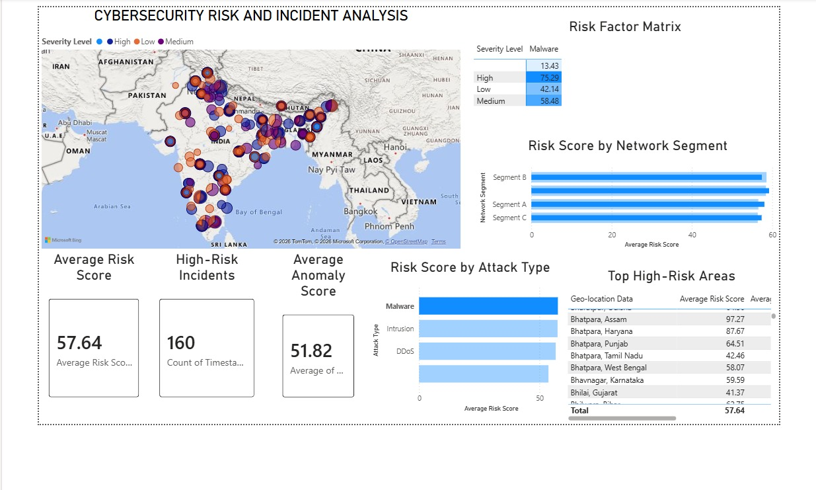
DASHBOARD 06
Risk & Incident Analysis
KEY POINTS
1
Calculates an overall average risk score of 57.64 across 160 incidents.
2
A risk factor matrix cross-tabs severity against malware exposure.
3
Risk score is compared across network segments B, A, and C.
4
Top high-risk locations are ranked in a sortable, scrollable table.
Data Visualization Patterns · Team 1 · Milestone-3
6 / 14

Slide 8
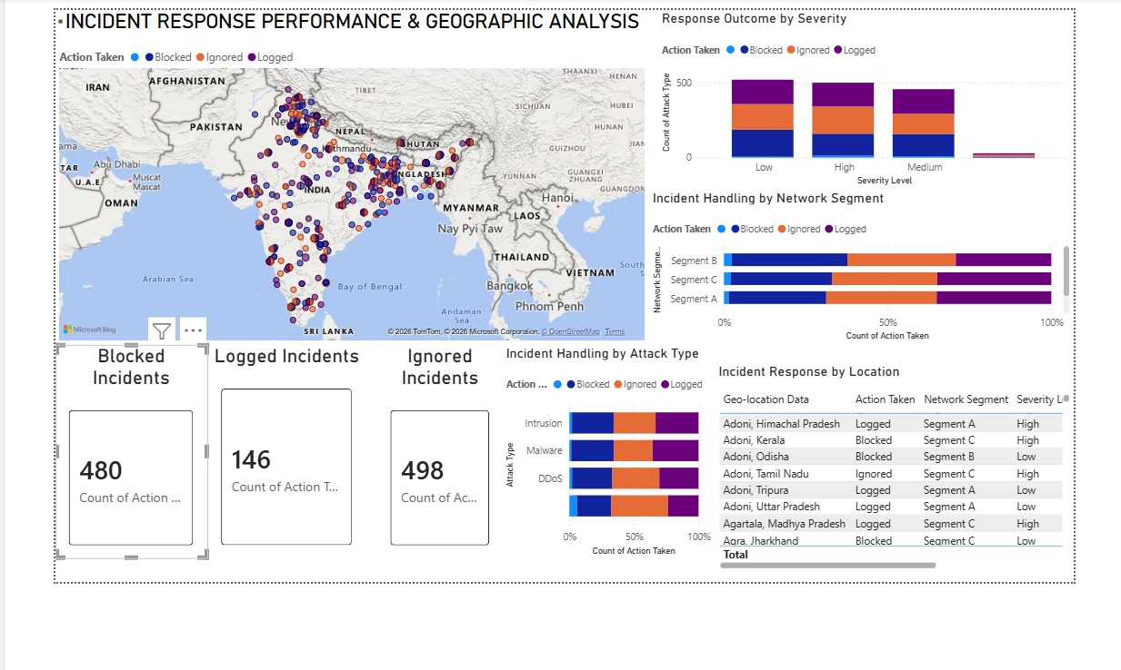
DASHBOARD 07
Incident Response Performance & Geography
KEY POINTS
1
Summarizes outcomes: 480 blocked, 146 logged, and 498 ignored incidents.
2
A map codes each incident by the action security teams actually took.
3
Stacked bars compare response outcomes across severity levels.
4
Handling is further split by network segment and by attack type.
Data Visualization Patterns · Team 1 · Milestone-3
7 / 14

Slide 9
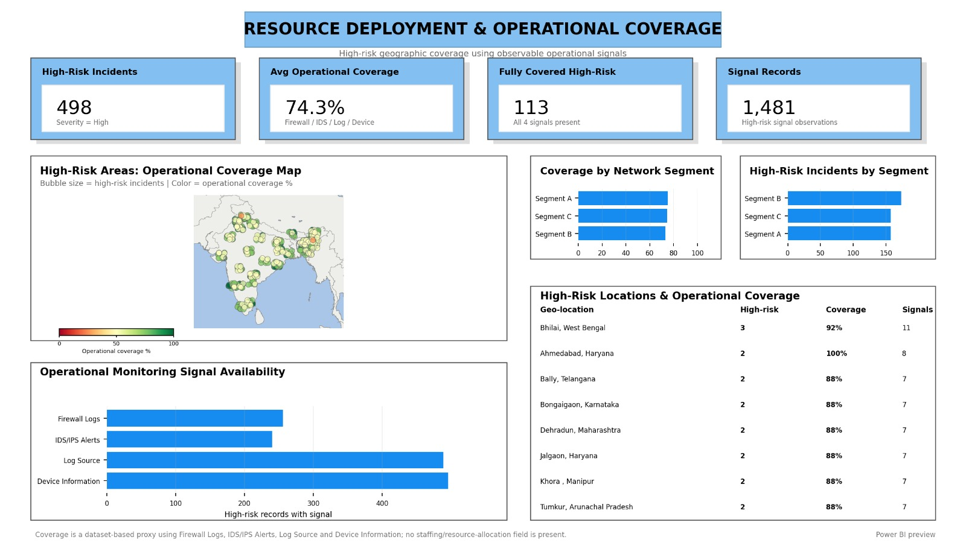
DASHBOARD 08
Operational Coverage — Signal Availability
KEY POINTS
1
Measures 498 high-risk incidents against 74.3% average operational coverage.
2
113 locations have full monitoring coverage across all four signal types.
3
A bubble map sizes incidents by volume and colors them by coverage percent.
4
Signal availability is broken out by firewall, IDS, log source, and device.
Data Visualization Patterns · Team 1 · Milestone-3
8 / 14

Slide 10
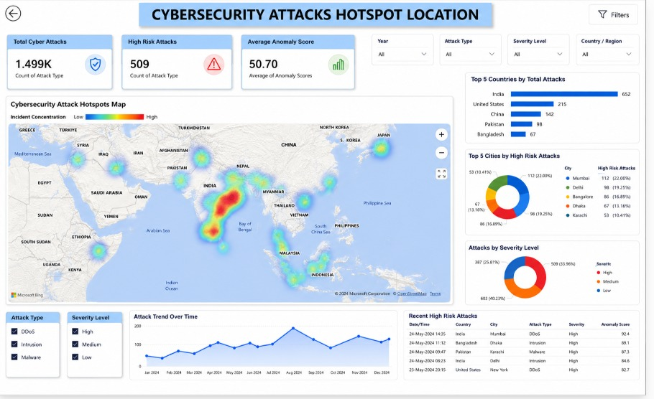
DASHBOARD 09
Attack Hotspots — Heat Map View
KEY POINTS
1
A heat map visualizes incident concentration instead of discrete pins.
2
India leads with 652 attacks, followed by the US, China, and Pakistan.
3
Mumbai and Delhi top the list of cities by high-risk attack count.
4
A trend line and live table surface the most recent high-risk events.
Data Visualization Patterns · Team 1 · Milestone-3
9 / 14

Slide 11
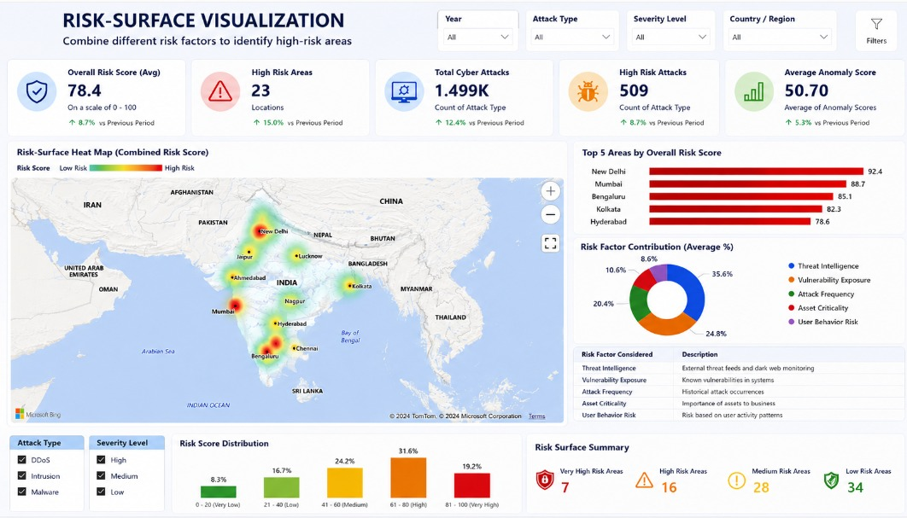
DASHBOARD 10
Risk-Surface Visualization
KEY POINTS
1
Blends five risk factors into one overall score, averaging 78.4 of 100.
2
23 locations are flagged as high-risk areas on the combined heat map.
3
New Delhi and Mumbai top the ranking of areas by overall risk score.
4
Risk scores are distributed into five bands from very low to very high.
Data Visualization Patterns · Team 1 · Milestone-3
10 / 14

Slide 12
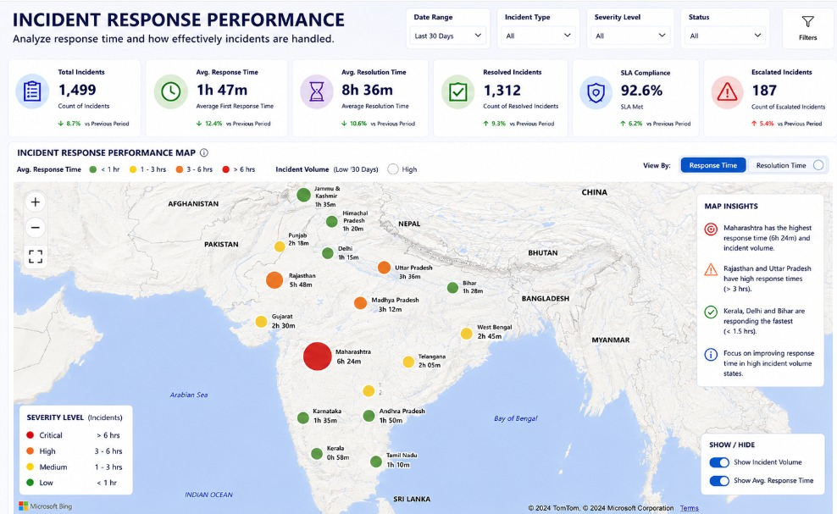
DASHBOARD 11
Incident Response Performance
KEY POINTS
1
1,499 incidents average a 1h 47m first response and 8h 36m resolution.
2
SLA compliance holds at 92.6%, with 187 incidents escalated further.
3
A state-level map color-codes India by average response time.
4
Callouts flag Maharashtra as slowest and Kerala/Delhi/Bihar as fastest.
Data Visualization Patterns · Team 1 · Milestone-3
11 / 14

Slide 13
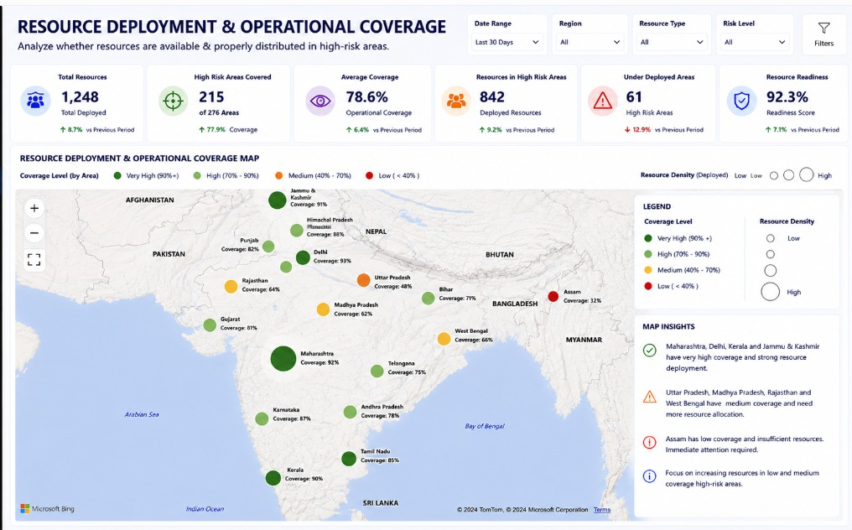
DASHBOARD 12
Resource Deployment Coverage Map
KEY POINTS
1
1,248 resources are deployed, covering 215 of 276 high-risk areas.
2
Average operational coverage reaches 78.6%, with a 92.3% readiness score.
3
State markers size by resource density and color by coverage level.
4
Insights flag Assam as under-covered and needing immediate attention.
Data Visualization Patterns · Team 1 · Milestone-3
12 / 14

Slide 14
Conclusion & Final Outcome
Across 12 dashboards, the analysis translated 1.499K raw cybersecurity records into clear, decision-ready visuals — spanning attack hotspots, severity trends, risk scoring, incident response, and resource coverage.
1
2
3
4
Visibility
Prioritization
Response
Readiness
Geo-mapped hotspots and heat maps expose where high-risk attacks concentrate.
Risk scoring and severity breakdowns rank which areas and attack types need attention first.
Incident response dashboards track SLA compliance, resolution time, and escalation rates.
Coverage and resource-deployment views flag under-protected regions like Assam for action.
NEXT STEPS
1
Automate real-time data refresh so dashboards reflect live attack feeds.
2
Set alert thresholds on anomaly scores to trigger faster incident response.
3
Extend resource-deployment coverage to under-served, high-risk regions.
TEAM 1
Chandra Harshitha | Abhilash Reddy | Sartak Raj | Tasleem Banu
Data Visualization Patterns · Team 1 · Milestone-3
14 / 14

